Slide 1

SUMMER OLYMPICS ANALYSIS
Is there a home field advantage?

Slide 2
Overview
Dataset: https://www.kaggle.com/divyansh22/summer-olympics-medals
Hypothesis: The athletes representing the host country tend to win more medals than those representing other countries
Variables:
City: Name of the city hosting the events
Year: Year of the Olympics
Sport: Category of sports (Aquatics, Volleyball, Fencing, etc)
Discipline: Subcategory of sports (Diving, Swimming, Water Polo, etc)
Event: Specific event of discipline (3m Springboard, 10m platform, etc)
Athlete: Name of winning athlete
Gender: Gender of winning athlete
Country_Code: 3-character country code of country represented by winning athlete
Country: Name of country represented by winning athlete
Event_gender: Gender which participates in the event (Male, Female, or Common)
Medal: Medal won (Gold, Silver, Bronze)
Host_Country**: Name of the country hosting the events
Host_Win**: Binomial variable representing if the Host Country won a medal (‘1’ for a medal win, ‘0’ otherwise)
Bold: Has impact on analysis
**: New variable created by analyst

Slide 3
Histograms

Slide 4
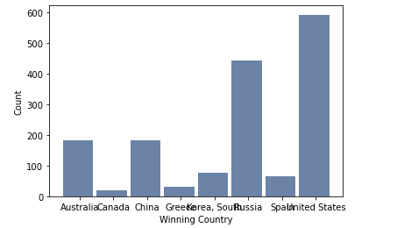
Medals won while hosting
We see that Canada has the lowest amount of medals won during the Summer Olympics that they hosted, while the United States has the highest total amount. However, we know that the United States hosted twice.

Slide 5
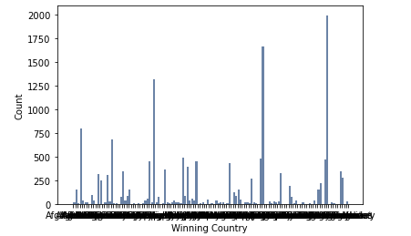


Total medals won by all countries
It is difficult to determine the countries' names based on this histogram, as there are 125 unique countries.
Using the head() and tail() functions, we can see the 5 countries with the most amount of medals and 5 countries with the least amount. This corresponds with our histogram
We can also see outliers like United States, Russia, and Germany, having 1000+ medals while there are 22 countries with only 1, or none, as the data set only contained countries which had won a medal.

Slide 6
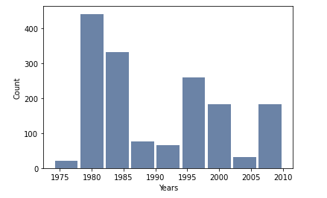
Medals won by host countries by Year
The year with the highest number of medals won by the host country is 1980, when Russia hosted. Due to the fact that the United States hosted in 1984 and 1996, this allows more insight into the total number of medals won by host countries.

Slide 7
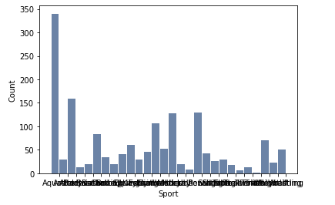


Sports that Hosting Winners won Medals in
Despite Aquatics making up only 14% of the events in the Summer Olympics (right), 21% of the Hosting Countries' Medals (left) were from Aquatics events. Gymnastics shows a similar, if smaller, difference

Slide 8
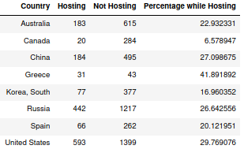
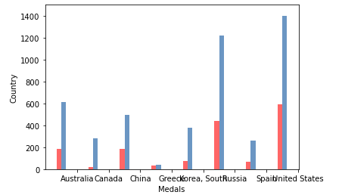
Medals won by Host Countries: not hosting (blue) vs. hosting (red)
While Greece did not win many medals total (74), they had the highest percentage of medals won while they were hosting – 41.89%.
Canada was the lowest with only 6.58% of the medals they won being while they were hosting.

Slide 9
Descriptive statistics

Slide 10
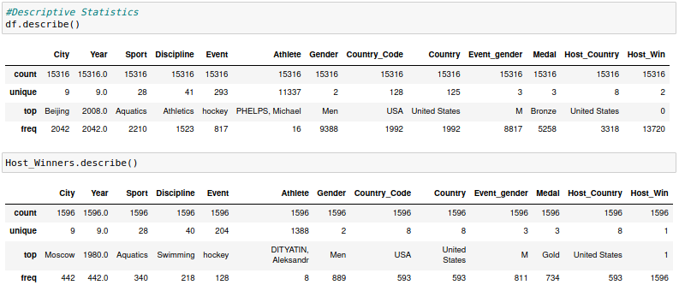
Initial Observations:
-Even though Aquatics is the top Sport, it is not the top Discipline or Event in the original df and not the top Event in the Host Winners df. It could indicate that it encompasses many disciplines and events, but the individual Disciplines and Events are small groups. Additionally, hockey is the top event, but this could be due to the fact that it is a team sport, and it is covering many rows for each individual team player.
-USA is the top Country and Host Country in both dfs
-Men is the top Gender and Event Gender in both dfs. This can indicate that there are more Men specific events, leading to more medals for Men overall. Different analysis is needed to determine if Men win more medals for host countries than Women.

Slide 11
Medals Won by All Countries:
Mean: 122.528
Standard Deviation: 287.42325
Variation: 82,784.6706
Range = 1,992 – 1 = 1,991
Medals Won by the Hosting Country:
Mean: 199.5
Standard Deviation: 209.6262
Variation: 43,943.1429
Range: 593 – 20 = 573
The Mean is for medals won by the Hosting Country is higher than for all other countries, indicating that the countries that have hosted tend to win more medals overall.
The range is much lower, which could be an explanation for the lower standard deviation and variance, but they are still very high, meaning that the values do not stay close to the mean (they are all over the place!)

Slide 12
Probability Mass functions

Slide 13
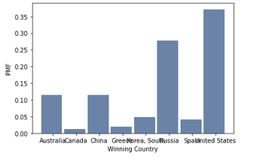
PMF of Medals won by Host Countries
Indicates that if the hosting country won a medal, there is a 37% chance that the country is the United States.

Slide 14
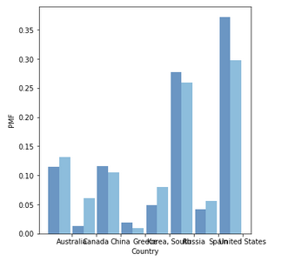
PMF of Medals Won by Host Countries: Hosting vs. Not Hosting
This indicates that Australia, Canada, South Korea, and Spain are have a lower probabiliyy of winning when they host vs when they are not hosting, while China, Greece, Russia, and the United States have a higher probability to win when they do host.

Slide 15
Cumulative distribution function

Slide 16
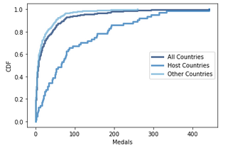
CDF of Medals Won
This supports the statistics, showing that Host Countries tend to win more medals overall. For Host Countries, winning 200 medals places the country in the 80th percentile, while for All Countries, it places the country in the 95th+ percentile.

Slide 17
Analytical distribution

Slide 18
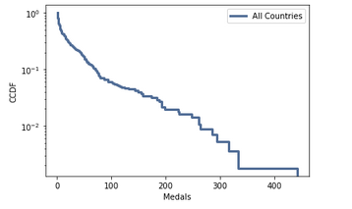
Exponential Distribution
What the CCDF looks like on a log-y scale. A straight line is consistent with an exponential distribution.

Slide 19
Line and scatter plots

Slide 20
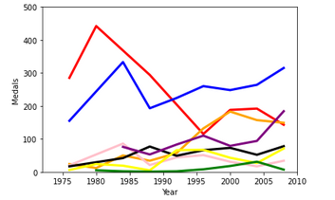

Interesting Note: We can see on this chart that on the years that each country hosted, the number of medals that they won increased (ex: United States in 1984 and 1996)

Slide 21
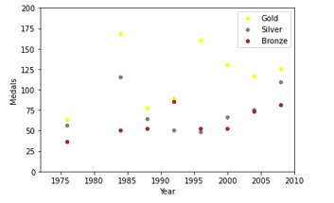
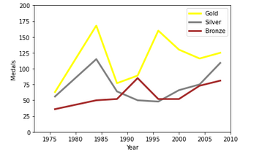
Similar to the previous slide, we see that the number of gold medals won by the United State increased in the years they hosted

Slide 22
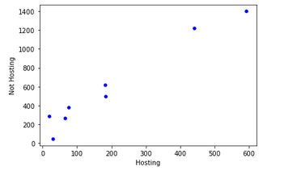
Medals Won by Host Countries
Covariance: 85,988.846
Correlation: .98034
Spearman Corr: .90476
These numbers indicate a strong positive correlation between the number of medals won while hosting and number of medals won while not while hosting

Slide 23
Regression analysis

Slide 24
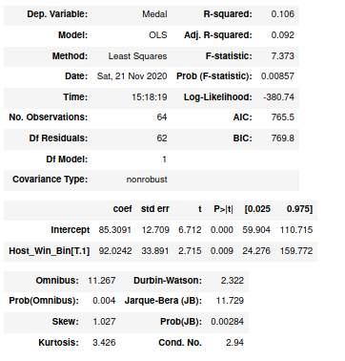
Medal vs Being the Host
R-squared is .106, which indicates that being the host accounts for 10.6% of medals won.
Starting at an average of 85 medals, the number of medals goes up, on average, to 92 when hosting.

